Slide 1
Chapter 16: The Brain

Slide 2
Ch 16: The Brain and Cranial Nerves
Gross Organization of the Brain
Meninges and CSF
Hind brain
Mid brain
Forebrain
Cranial nerves

Slide 3
Embrological Organization
Telencephelon
Cerebrum and lateral ventricles
Diencephalon
Thalamus, Hyopthalamus, third ventricles
Mesencephalon
Midbrain and cerebral aqueduct
Metencephalon
Cerebellum, pons, fourth ventricle
Myelencephalon
Medulla Oblongata and fourth ventricle

Slide 4
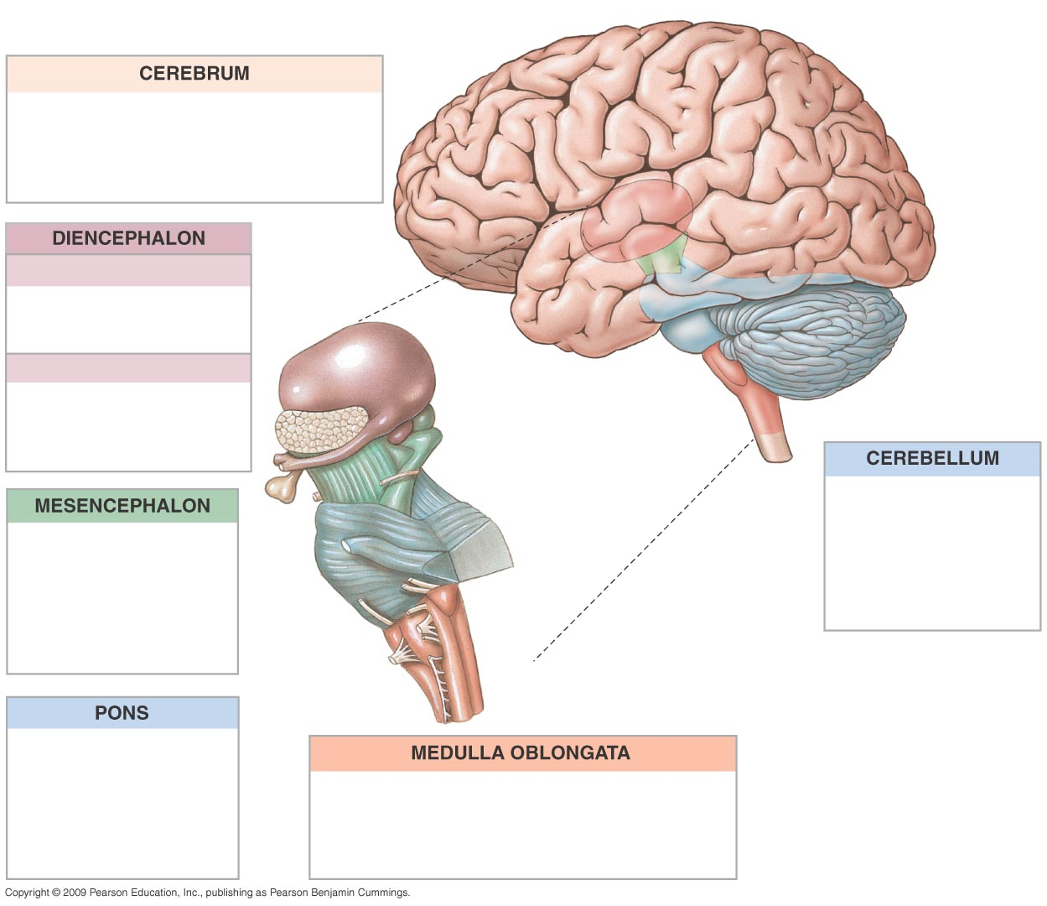
LE 15-1
Left cerebral
hemisphere
Gyri
Conscious thought processes,
intellectual functions
Memory storage and processing
Conscious and subconscious regulation
of skeletal muscle contractions
Sulci
Fissures
THALAMUS
Relay and processing
centers for sensory
information
HYPOTHALAMUS
Centers controlling
emotions, autonomic
functions, and hormone
production
Spinal
cord
Coordinates complex
somatic motor
patterns
Adjusts output of
other somatic motor
centers in brain and
spinal cord
Processing of visual
and auditory data
Generation of reflexive
somaic motor
responses
Maintenance of
consciousness
Brain
stem
Relays sensory
information to
cerebellum and
thalamus
Subconscious
somatic and visceral
motor centers
Relays sensory information to thalamus and
to other portions of the brain stem
Autonomic centers for regulation of visceral
function (cardiovascular, respiratory, and
digestive system activities)

Slide 5
Ventricles
Open areas of the brain
Filled with Cerebral Spinal Fluid, lined with Ependymal cells
Lateral ventricles (considered first and second)
Separated by Septum pellucidum
Third ventricle
Communicates with each lat ventricle through an interventricular foramen
Provides nutrition on neurons
Cushions the brain

Slide 6
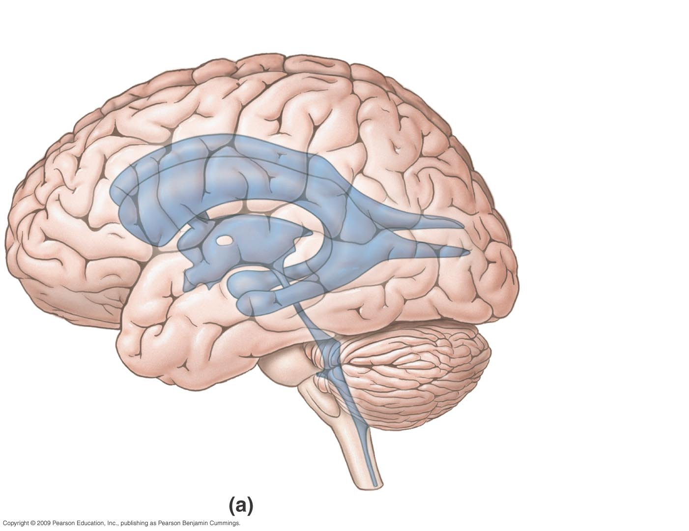
LE 15-2a
Cerebral
hemispheres
Anterior horns of
lateral ventricles
Lateral ventricles
Interventricular
foramen
Third ventricle
Posterior horns
of lateral
ventricles
Inferior horns of
lateral ventricles
Pons
Aqueduct of
midbrain
Medulla oblongata
Fourth
ventricle
Central canal
Spinal cord
Cerebellum
Lateral view

Slide 7
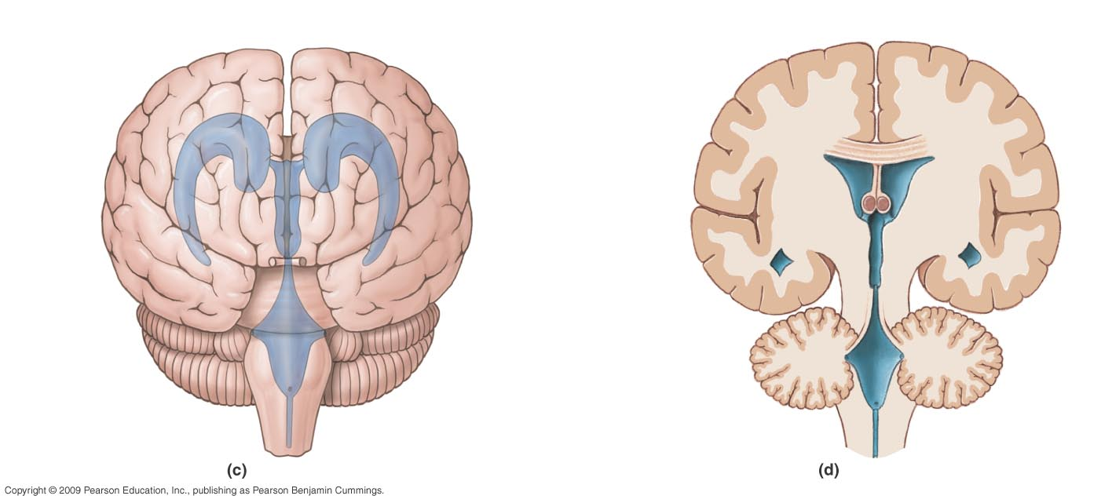
LE 15-2cd
Lateral ventricles in
cerebral hemispheres
Longitudinal
fissure
Lateral ventricles
Interventricular
foramen
Interventricular
foramen
Third
ventricle
Third
ventricle
Inferior horns
of lateral
ventricles
Aqueduct
of midbrain
Inferior horn of
lateral ventricle
Pons
Fourth
ventricle
Aqueduct of
midbrain
Septum
pellucidum
Cerebellum
Medulla
oblongata
Fourth
ventricle
Central canal
Central canal
Anterior view
Coronal section

Slide 8
Cranial Meninges: The dura mater
Outermost CT membrane
Contains dural sinus
Fused to periosteum of the vault of cranium
Several folds
Falx cerebri: attach to crista galli
Tentorium cerebelli: between occipital lobes and cerebellum
Falx cerebelli: divides cerebellar hemispheres
Diaphragma sellae: inferior from sella tursica to pituitary gland.

Slide 9
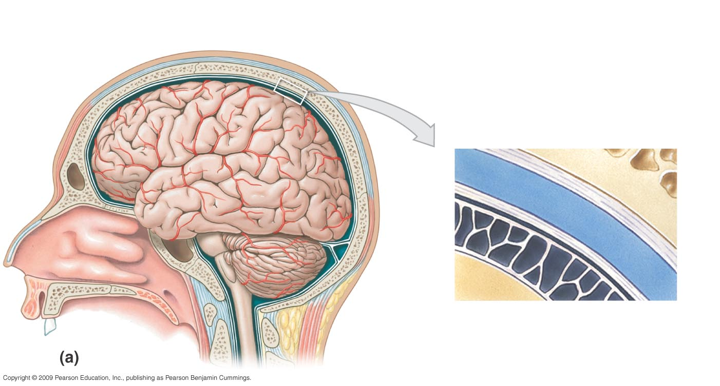
LE 15-3a
Cerebral
cortex
Cerebellum
Medulla
oblongata
Dura mater
(meningeal layer)
Dura mater
(endosteal
layer)
Dural
sinus
Cranium
Cerebral
cortex
Subarachnoid
space
Subdural
space
Spinal
cord
Pia
mater
Lateral view
Arachnoid
mater

Slide 10
Arachnoid mater
Named for spider web like connective tissue
Subdural space
Between arachnoid mater and dura mater
Subarachnoid space
Connective tissue attachments to pia mater
Projections into venous sinues
Arachnoid granulations

Slide 11
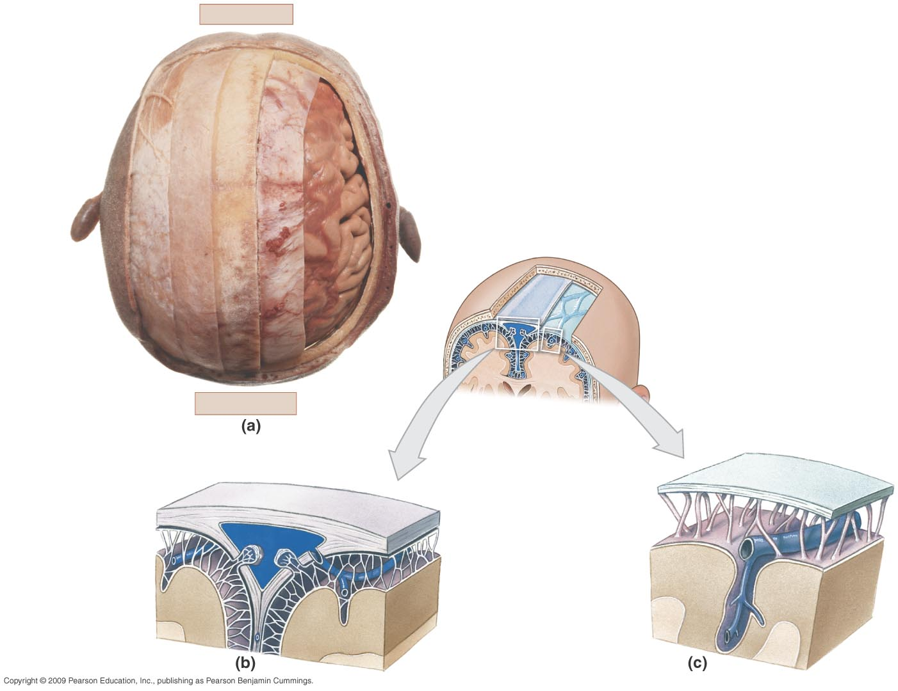
LE 15-4
ANTERIOR
Loose
connective
tissue and
periosteum
of cranium
Cranium
Dura mater
Epicranial
aponeurosis
Subarachnoid space
Scalp
Arachnoid mater
Cerebral cortex
covered by pia mater
POSTERIOR
Coronal section
Superior sagittal
sinus
Arachnoid mater
Dura mater
Arachnoid
trabecula
Subdural space
Arachnoid
mater
Cerebral
vein
Arachnoid
granulation
Arachnoid
trabeculae
Pia mater
Cerebral
cortex
Falx cerebri
Pia mater
Subarachnoid
space
Cerebral cortex
Perivascular
space

Slide 12
Cerebrospinal Fluid
Physical support of the brain
Chemical support of the brain
Freely permeable with interstitial fluid surrounding neurons
Formation
Choroid plexus: Specialized ependymal cells
Produces 500ml/day, replaced every 8 hrs
Circulation
Produced in lateral ventricles – down to central canal – flows fourth ventricle into subarachnoid space – general circulation through arachnoid granulations

Slide 13
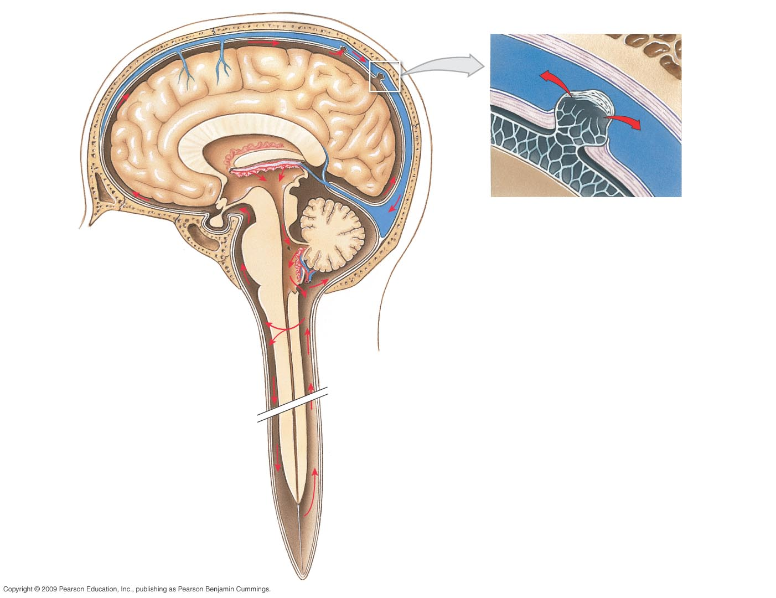
LE 15-6
Arachnoid
granulations
Superior
sagittal sinus
Dura mater
(endosteal
layer)
Cranium
Extension of
choroid
plexus into
lateral
ventricle
Arachnoid
granulation
Fluid
movement
Arachnoid
trabecula
Cerebral
cortex
Dura mater
(meningeal
layer)
Pia
mater
Choroid
plexus of
third ventricle
Superior
sagittal
sinus
Subarachnoid
space
Subdural
space
Arachnoid
mater
Aqueduct
of midbrain
Lateral aperture
Choroid plexus of
fourth ventricle
Central canal
Median aperture
Arachnoid mater
Subarachnoid space
Spinal cord
Dura mater
Filum terminale

Slide 14
Blood Brain Barrier
Produced by astrocytes around capillaries
Partially permeable
Lipids
Active transport for glucose, ions, large proteins
Monitored by exposed capillaries close to hypothalamus and pineal glands

Slide 15
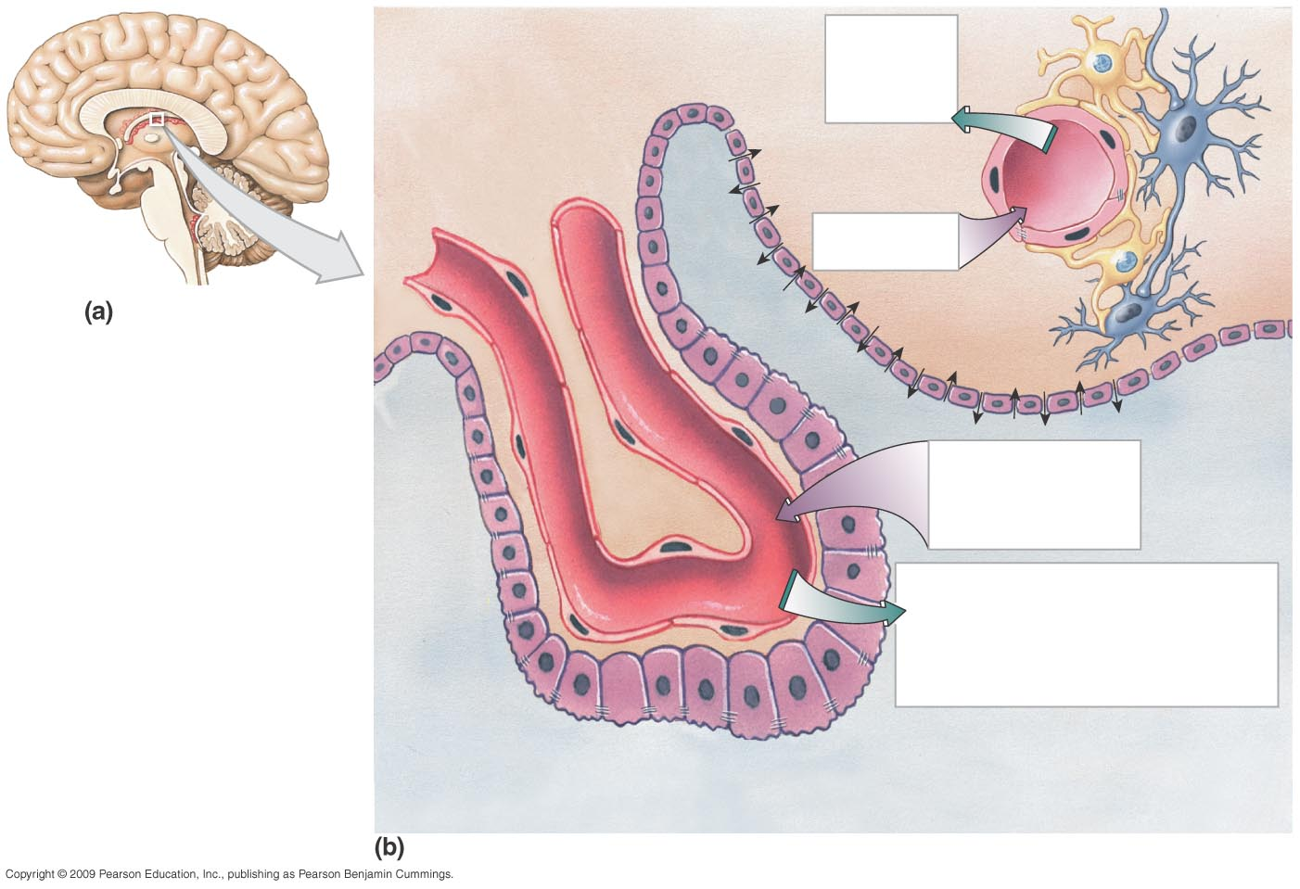
LE 15-5
INTERSTITIAL FLUID IN THALAMUS
Nutrients
(especially
glucose)
Oxygen
Ependymal cells
Choroid
plexus cells
Capillary
Capillary
Endothelial cell
CO₂ Waste
products
Blood
brain
barrier
Tight
junction
Choroid plexus
Astrocyte
Neuron
Waste products
Ions
Amino acids
(when necessary)
Ions
(Na⁺, K⁺, Cl–, HCO₃–, Ca²⁺, Mg²⁺)
Vitamins
Organic nutrients
Oxygen
Tight junction
CHOROID PLEXUS
CEREBROSPINAL FLUID IN THIRD VENTRICLE

Slide 16
Regions of the brain: Medulla Oblongata
Myelencephalon
Connects spinal cord to brain
Relay stations
Nuclei of cranial nerves
CN VIII, IX, X, XI, XII
Autonomic nuclei
Cardiovascular centers
Respiratory rhythmicity centers

Slide 17
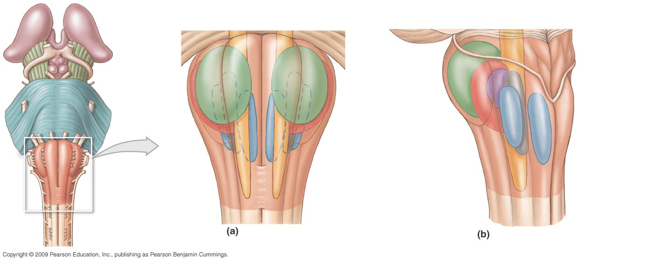
LE 15-20
Olivary nucleus
Attachment to
membranous
roof of fourth
ventricle
Cardiovascular
centers
Pons
Respiratory
rhythmicity center
Medulla
oblongata
Solitary nucleus
Olive
Nucleus cuneatus
Pyramids
Nucleus gracilis
Posterior
median sulcus
Reticular formation
Spinal cord
Lateral white column
Posterior
white columns
Anterior view
Posterolateral view

Slide 18
Pons
Mesencephalon
Cranial nerve nuclei
CN V, VI, VII, VIII
Nuclei of invounary control of respiration
Apneustic center and pneumotaxic center
Transverse fibers connect cerebellum
Ascending and descending tracts

Slide 19
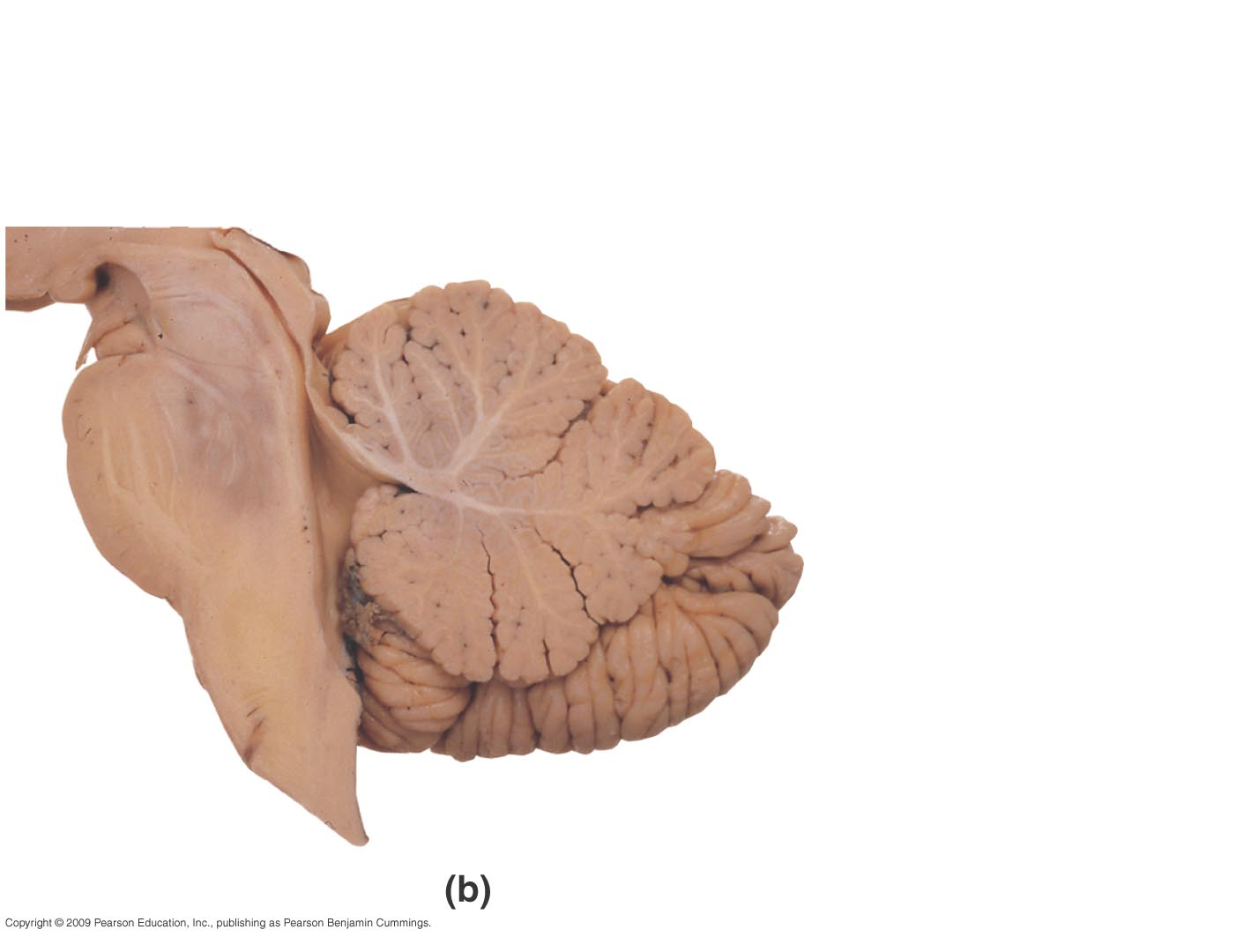
LE 15-19b_1
Superior colliculus
Aqueduct of midbrain
Mesencephalon
Mamillary
body
Inferior colliculus
Anterior lobe
Arbor vitae
Cerebellar
cortex
Pons
Cerebellar
nucleus
Flocculonodular lobe
Fourth
ventricle
Posterior lobe
Medulla
oblongata
Sagittal section

Slide 20
Cerebellum
“Little cerebrum”
Motor Planning

Slide 21
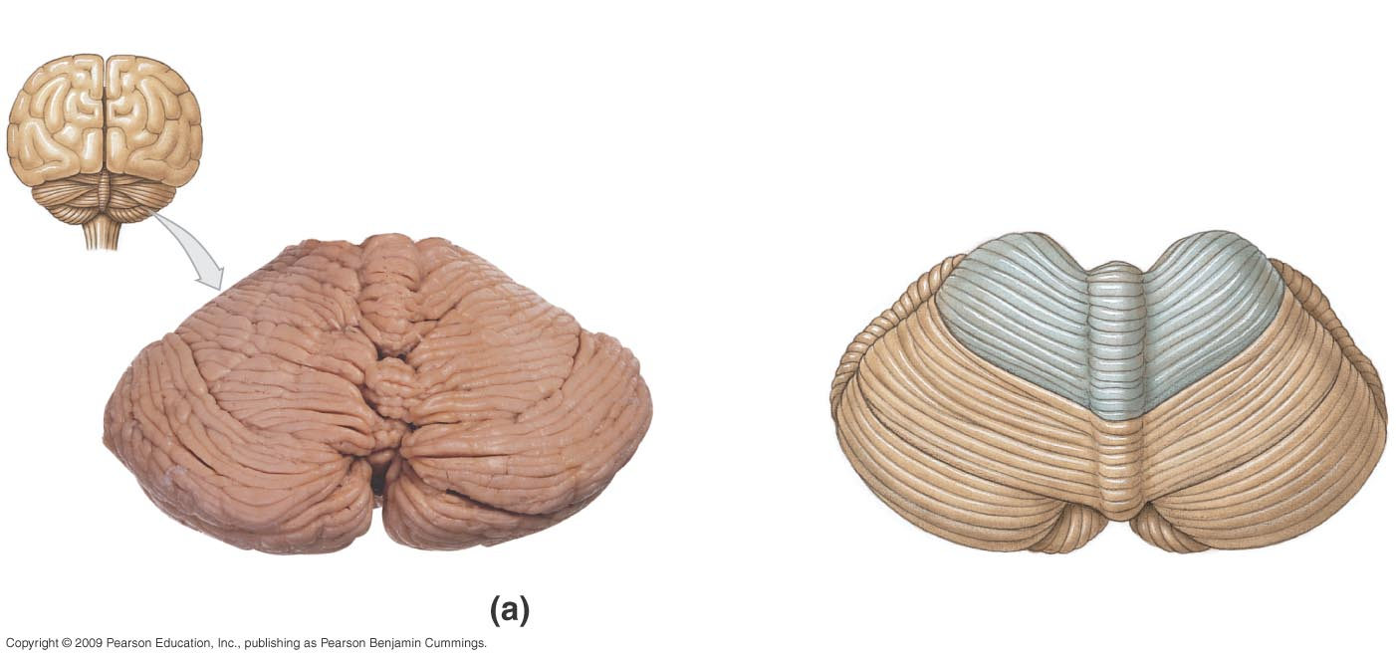
LE 15-19a
Cerebellum
Left
hemisphere
of cerebellum
Vermis
Anterior lobe
Vermis
Primary fissure
Folia
Posterior
lobe
Folia
Right hemisphere
of cerebellum
Posterior, superior surface

Slide 22
Mesencephalon
Corpora quadrigemina
Superior colliculus: visual processing
Inferior colliculus: auditory processing
Major nuclei of reticular formation
Red nucleus
Substantia nigra
Cerebral peduncles
Ascending and descending pathways to thalamus

Slide 23
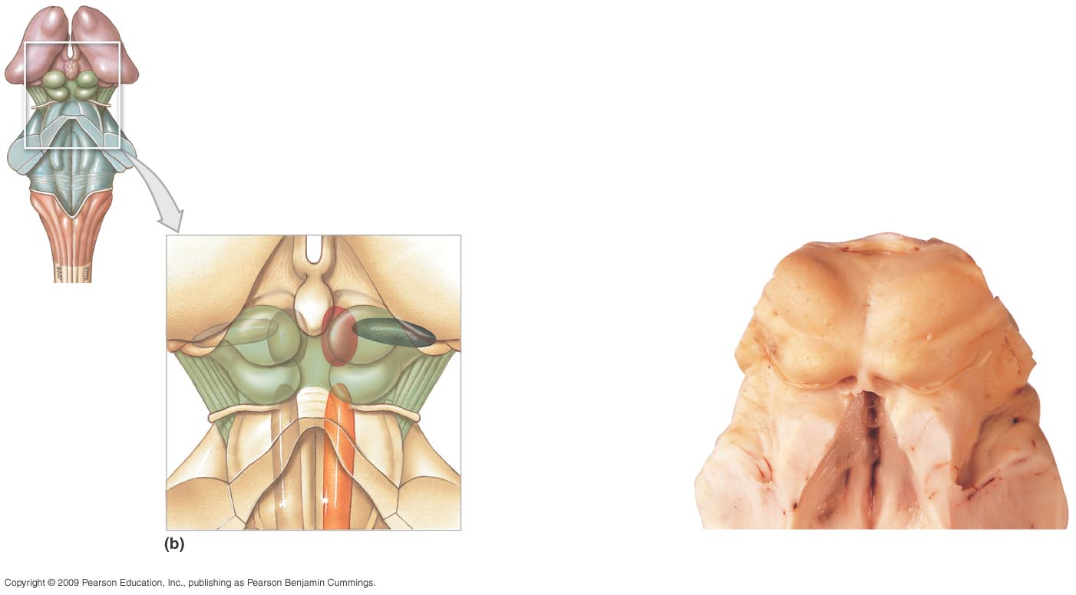
LE 15-17b
Thalamus
Superior
colliculi
Pineal
gland
Substantia
nigra
Corpora
quadrigemina
Superior
colliculus
Inferior
colliculi
Red nucleus
Cerebral
peduncle
Inferior
colliculus
Trochlear
nerve (N IV)
Cerebral
peduncle
Reticular
formation
Superior
cerebellar
peduncle
Posterior view
Reticular formation in
floor of fourth ventricle
Fourth
ventricle

Slide 24
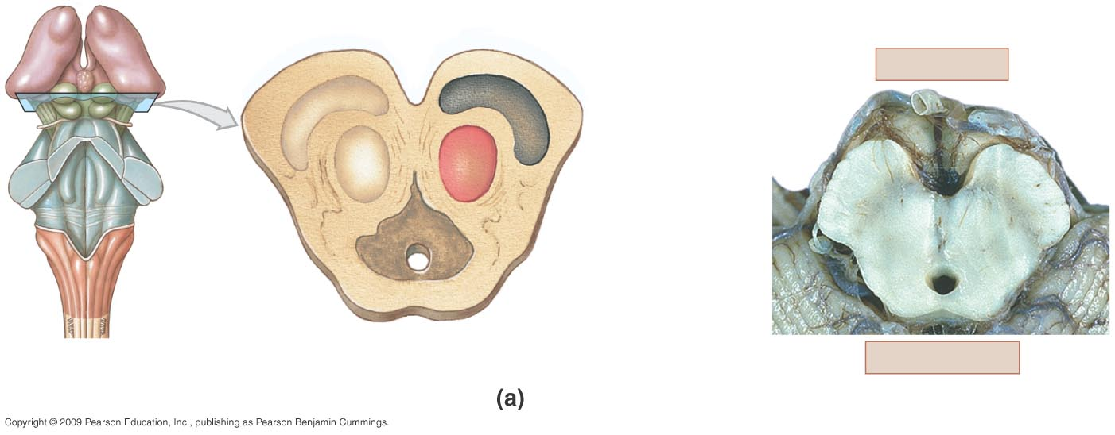
LE 15-17a
Cerebral
peduncle
ANTERIOR
Substantia
nigra
Cerebellum
Red nucleus
Gray matter
Aqueduct
of midbrain
Superior colliculus
Tectum (roof)
POSTERIOR
Transverse section, superior view

Slide 25
Diencephalon
Epithalamus
Roof of third ventricle
Pineal gland: produces melatonin
Thalamus
Muliple nuclei relax sensory information to basal nuclei and cerebrum
Hypothalamus
Autonomic functions
Emotions and behavioral drives
Endocrine and Neurological cross-over: pitutary gland

Slide 26
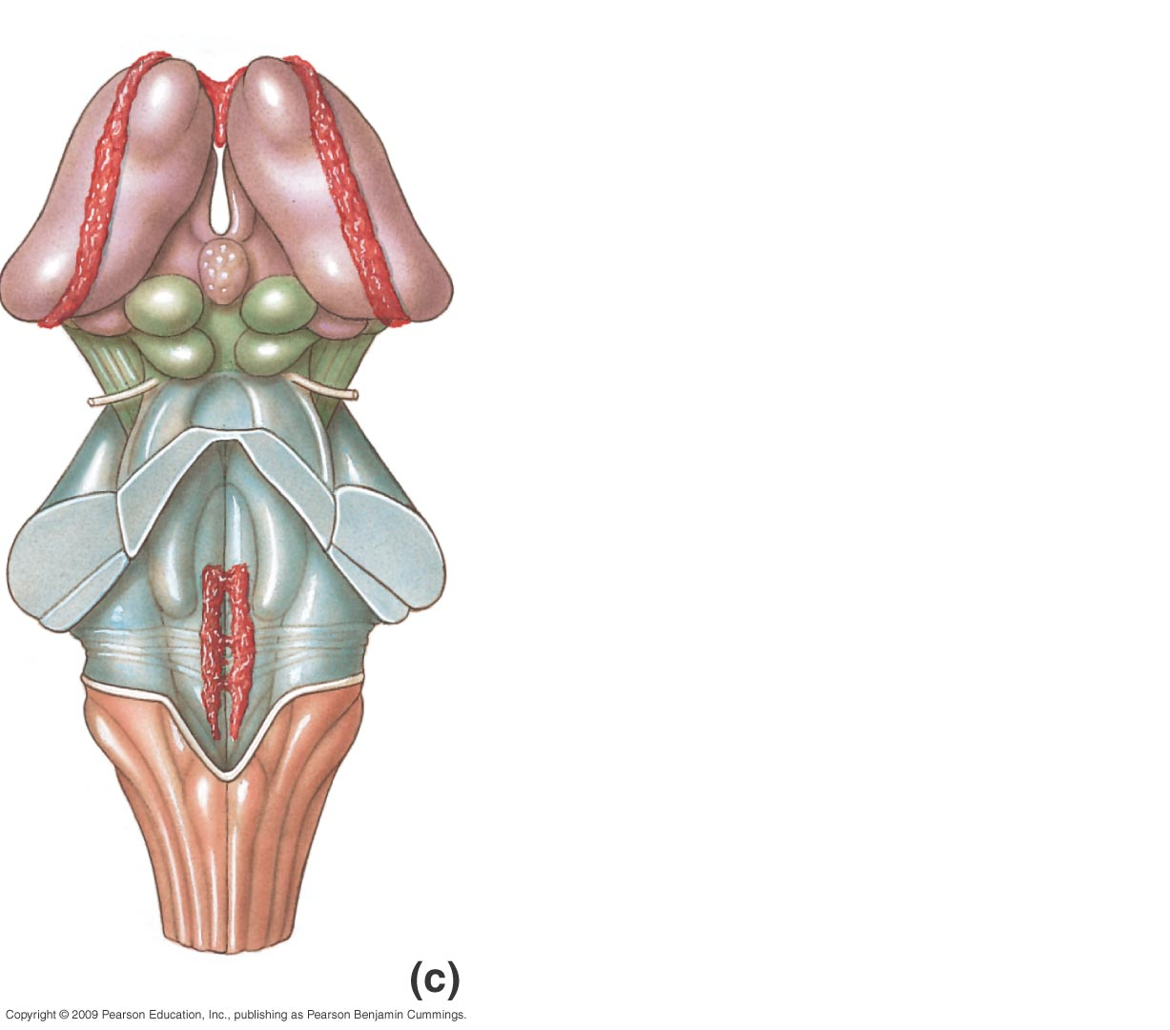
LE 15-16c
Choroid plexus
Third ventricle
Thalamus
Pineal gland
Superior colliculi
Corpora
quadrigemina
Inferior colliculi
Cerebral peduncle
Superior
Middle
Cerebellar
peduncles
Inferior
Choroid plexus in roof
of fourth ventricle
Posterior view

Slide 27
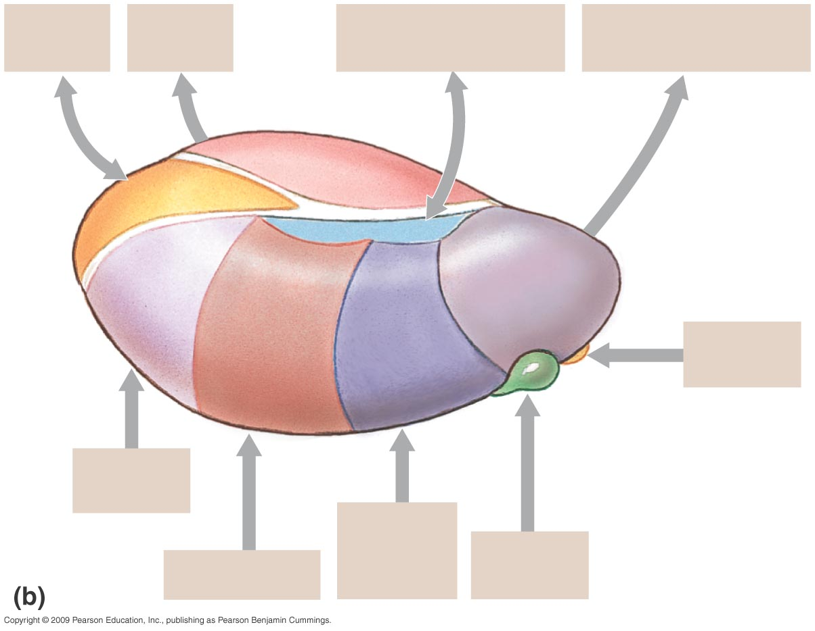
LE 15-13b
Limbic
system
Frontal
lobes
Parietal lobe and
cingulate gyrus
Association areas
of cerebral cortex
Anterior
group
Medial group
Lateral group
Posterior
group
Pulvinar
V e n t r a l
g r o u p
Auditory
input
Medial
geniculate
nucleus
Basal
nuclei
General
sensory
input
Lateral
geniculate
nucleus
Visual
input
Cerebellum
Notes:
Thalamus egg shaped, but different nuclei do do differnet functions

Slide 28
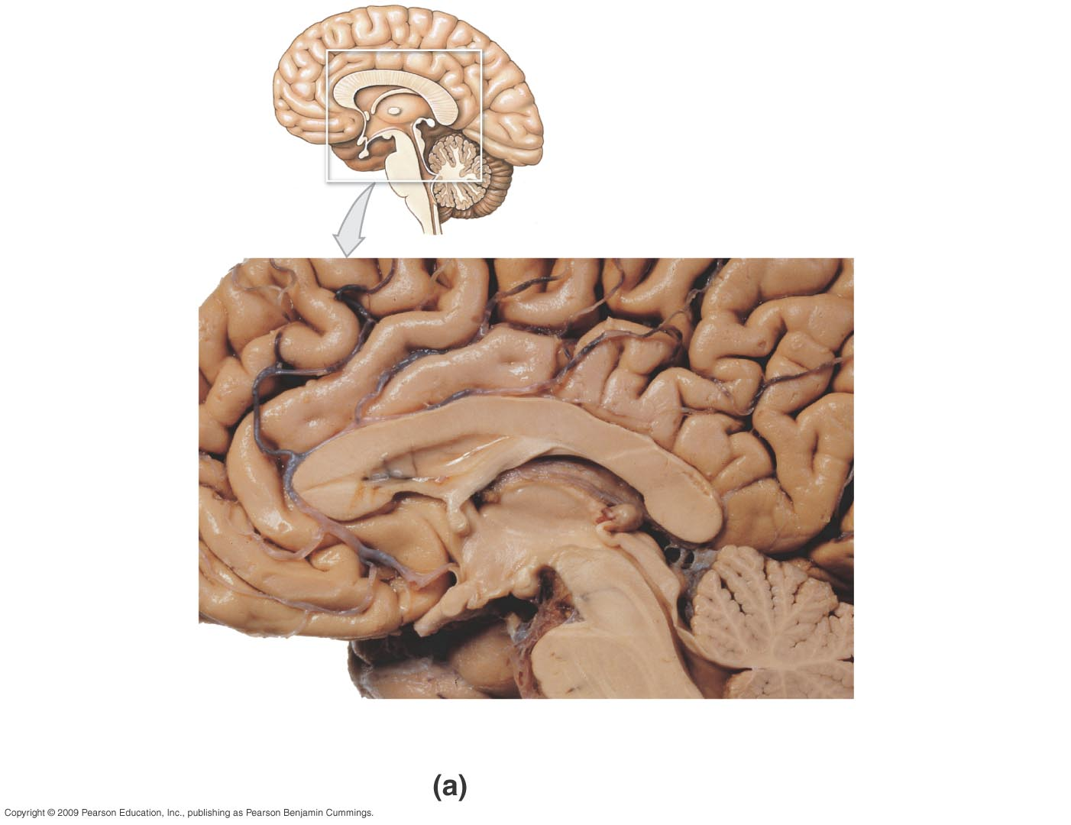
LE 15-14a
Thalamus
(surrounds
third ventricle)
Parietal
lobe
Choroid plexus
in epithalamus
Corpus
callosum
Fornix
Hypothalamus
Septum
pellucidum
Pineal gland
Tuberal area
Anterior
cerebral
artery
Mamillary
body
Frontal lobe
Aqueduct of
midbrain
Anterior
commissure
Cerebellum
Optic chiasm
Infundibulum (cut)
Fourth
ventricle
Optic nerve
Midsagittal section

Slide 29
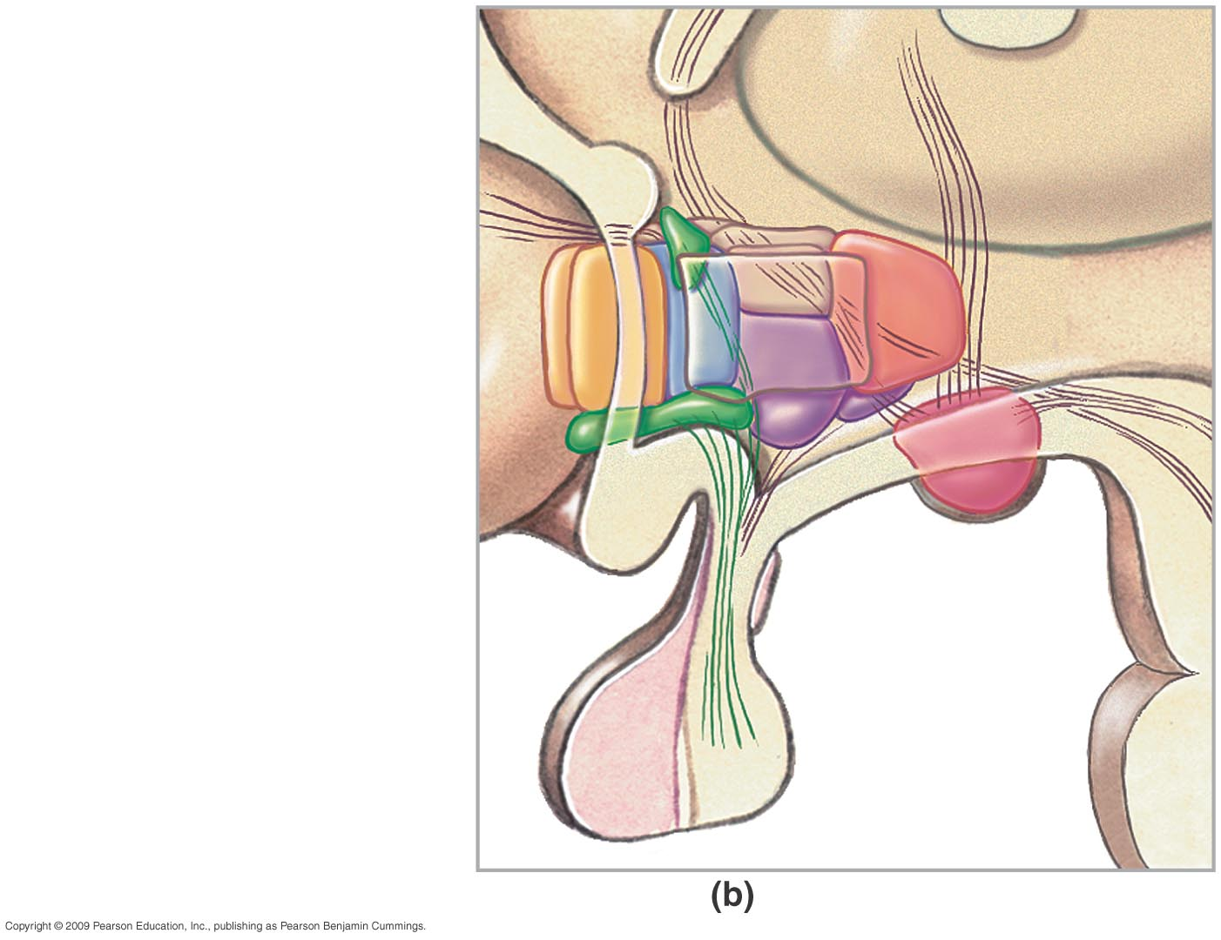
LE 15-14b
Autonomic centers
(sympathetic)
Thalamus
Paraventricular
nucleus
Preoptic area
Autonomic centers
(parasympathetic)
Hypothalamus
Suprachiasmatic
nucleus
Supraoptic nucleus
Tuberal nuclei
Optic chiasm
Mamillary
body
Tuberal
area
Infundibulum
Anterior
lobe of
pituitary
gland
Posterior lobe
of pituitary
gland
(pars nervosa)
Pars distalis
Pons
Pars intermedia
Hypothalamus
Notes:
Hypothalamus

Slide 30
Telencephelon
Basal Nuclei
Coordination of movement patterns
Limbic System
Emotions and memory
Cerebrum
Higher order processing, consciousness

Slide 31
Basal Nuclei
Caudate nucleus and putamen
Maintain walking rhythm
Claustrum and amygdaloid body
Visual processing
Specific patterns and features
Globus pallidus
Controls appendicular muscles in preparation for specific movement

Slide 32
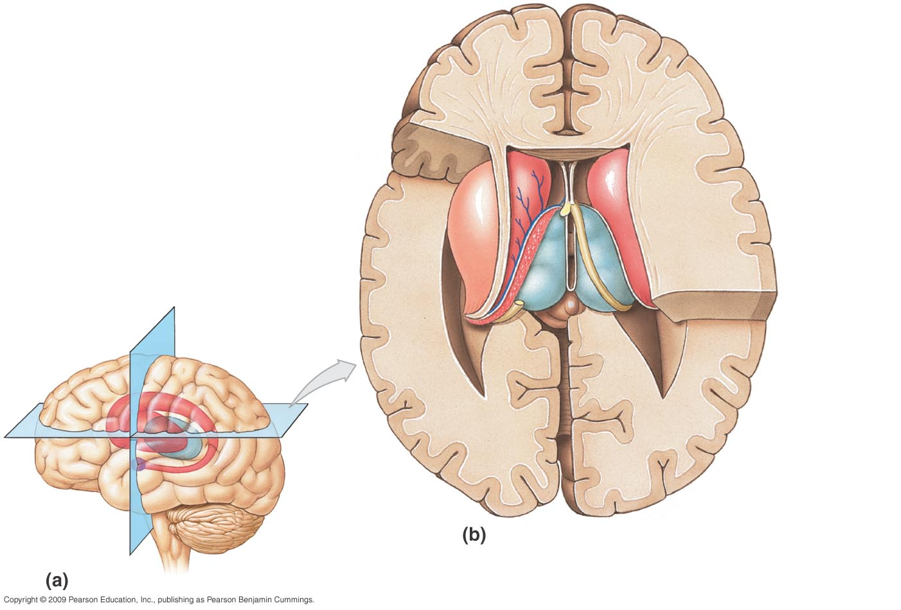
LE 15-11ab
Corpus callosum
Lateral ventricle
(anterior horn)
Septum
pellucidum
Head of caudate nucleus
Internal capsule
Putamen
Fornix (cut
edge)
Thalamus
Choroid plexus
Third
ventricle
Head of
caudate
nucleus
Pineal gland
Lentiform
nucleus
Fornix
Lateral ventricle
(posterior horn)
Tail of
caudate
nucleus
Amygdaloid
body
Thalamus
Horizontal section, dissected
Lateral view

Slide 33
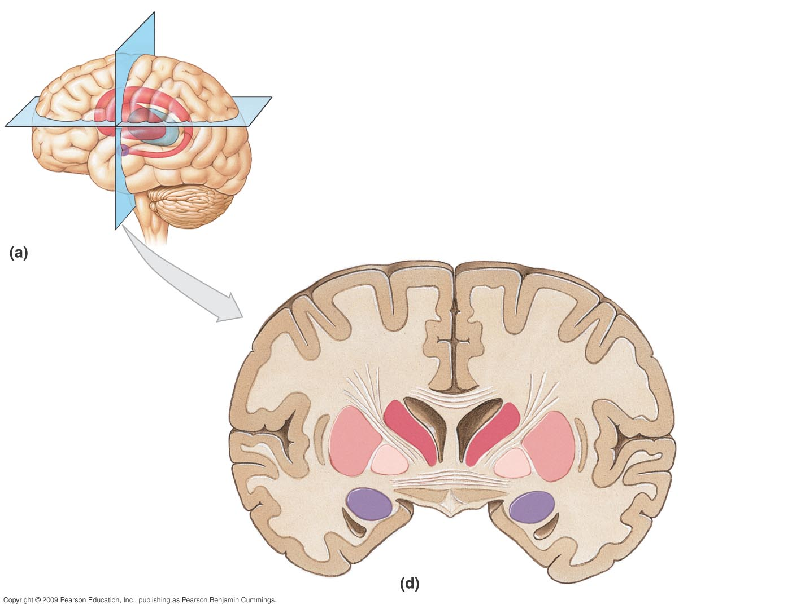
LE 15-11a,d
Head of
caudate nucleus
Lentiform
nucleus
Tail of caudate
nucleus
Thalamus
Amygdaloid
body
Lateral view
Corpus callosum
Septum pellucidum
Lateral ventricle
Internal capsule
Head of caudate
nucleus
Claustrum
Lateral sulcus
Insula
Anterior
commissure
Putamen
Lentiform
nucleus
Globus
pallidus
Tip of inferior
horn of
lateral ventricle
Amygdaloid body
Frontal section

Slide 34
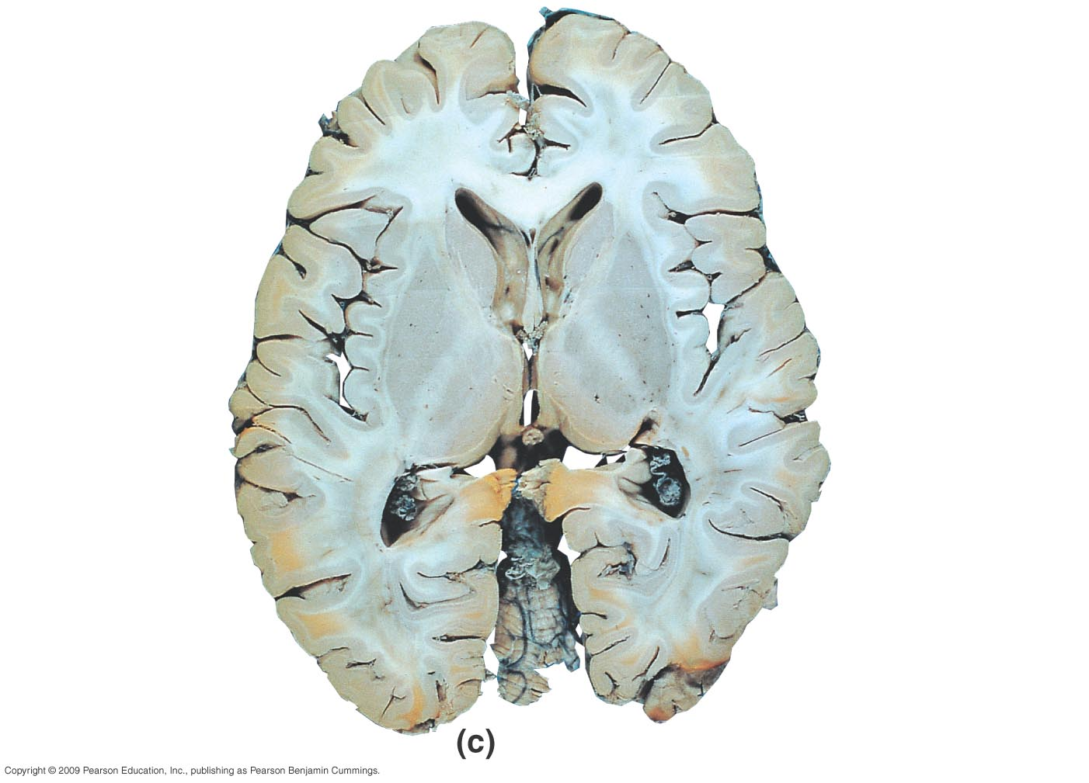
LE 15-11c
Lateral
ventricles
Corpus callosum
Caudate nucleus
Septum
pellucidum
Globus pallidus
Fornix
Putamen
Internal capsule
Claustrum
Third ventricle
Insula
Pineal gland
Internal
capsule
Posterior,
inferior horns
of lateral
ventricles
Thalamus
Cerebellum
Horizontal section

Slide 35
Limbic System
Amygdaloid body
Integrates
Hippocampus
Learning and long term memory storage
Fornix
White matter links hippocampus to hypothalamus
Mamillary bodies
Thalamus and hypothalamus
Reticular formation

Slide 36
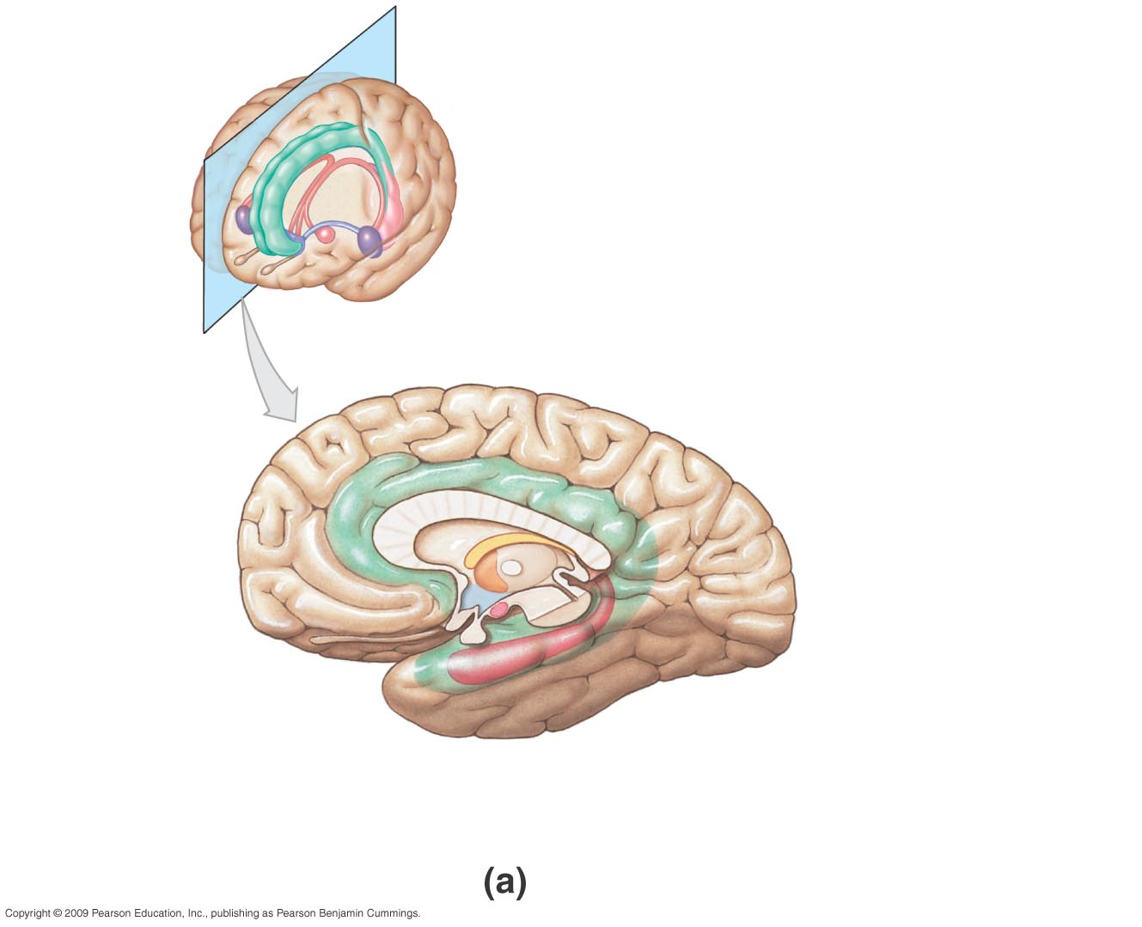
LE 15-12a
Cingulate gyrus
(limbic lobe)
Central
sulcus
Fornix
Corpus
callosum
Interthalamic
adhesion
Pineal gland
Thalamus
Temporal lobe
Hypothalamus
Parahippocampal
gyrus (limbic lobe)
Hippocampus
(within dentate gyrus)
Mamillary
body

Slide 37
Cerebrum
Conscious thought, intellectual functions
Hemispheres
Not symmetrical
Lobes
5 lobes
Wrinkles
Ridge: gyrus
Depression: sulcus
Deep depression: fissure

Slide 38
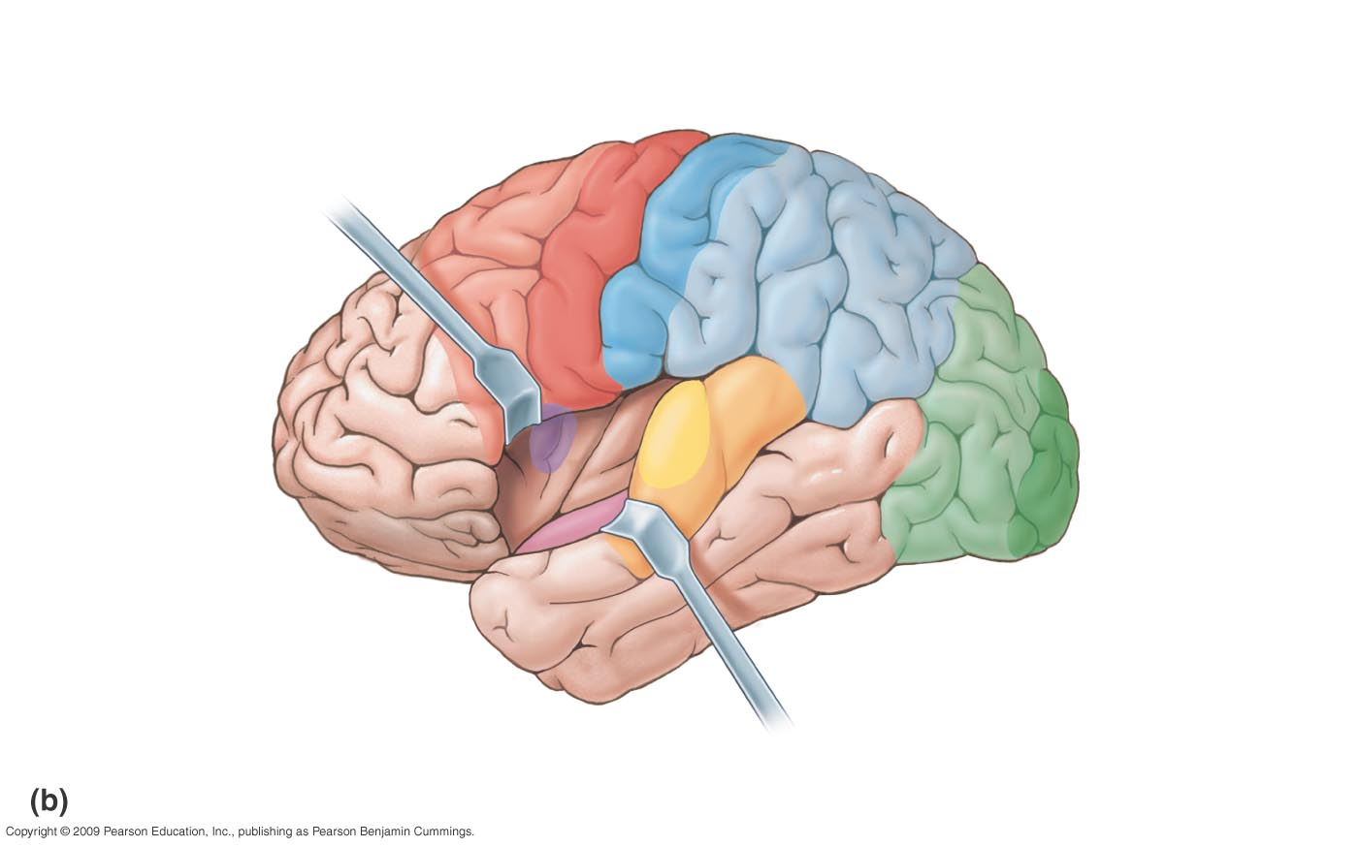
Frontal Lobe
Prefrontal cortex
abstract intellectual functions
Primary motor cortex
Control intentional movemements
Secondary motor association area

Slide 39
Parietal Lobe
Primary Sensory Cortex
Conscious awareness of sensory input
General Interpretive Area Interpretation of sensory information,
Usually located in one hemisphere, usually Left

Slide 40
Temporal Lobe
Auditory cortex
Olfactory cortex

Slide 41
Occipital Lobe
Visual Cortex
Visual Association Area

Slide 42
Insula
Gustatory cortex

Slide 43
White matter in the cerebrum
Arcuate fibers
From one gyrus to another
Corpus Callosum
Between hemispheres
Internal capsule
Between basal nuclei, cortex, cerebellum, thalamus

Slide 44
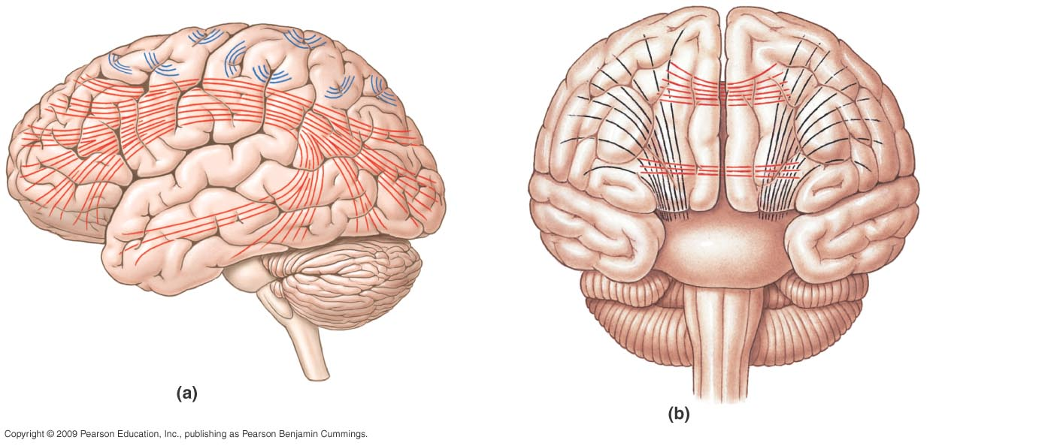
LE 15-10
Arcuate
fibers
Longitudinal
fissure
Corpus
callosum
Longitudinal
fasciculi
Projection
fibers of
internal
capsule
Anterior
commissure
Lateral view
Anterior view

Slide 45
Cranial Nerves
Nuclei originate in CNS: brain
You need to know:
Number and name
Where originate
Basic function, both motor and sensory
Clinically important: window into function of mid and hind brain

Slide 46
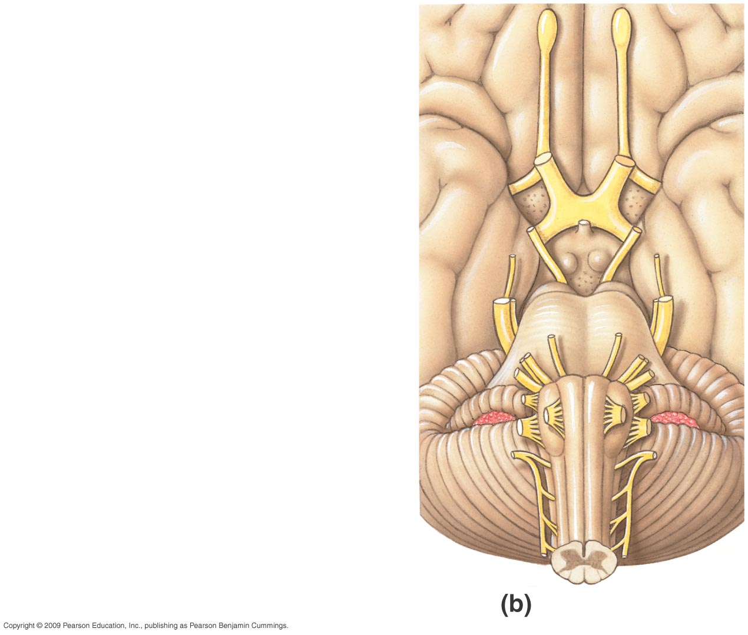
LE 15-21b
Olfactory bulb, termination
of olfactory nerve (N I)
Olfactory tract
Optic chiasm
Optic nerve (N II)
Infundibulum
Oculomotor nerve (N III)
Trochlear nerve (N IV)
Trigeminal nerve (N V)
Abducens nerve (N VI)
Facial nerve (N VII)
Vestibulocochlear nerve (N VIII)
Glossopharyngeal nerve (N IX)
Vagus nerve (N X)
Hypoglossal nerve (N XII)
Accessory nerve (N XI)
Inferior view

Slide 47
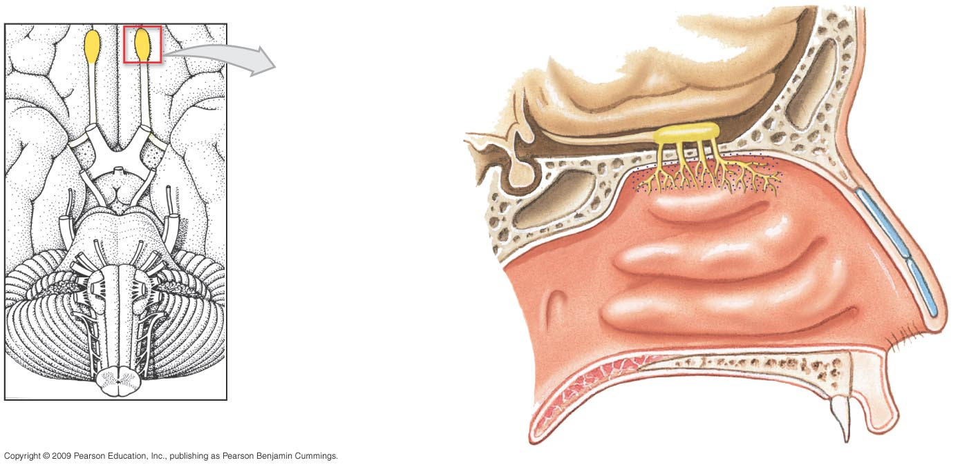
LE 15-22
Left olfactory bulb (termination
of olfactory nerve)
Olfactory tract
(to olfactory cortex
of cerebrum)
Olfactory
nerve fibers
OLFACTORY
NERVE (N I)
Cribriform plate
of ethmoid
Olfactory epithelium
Notes:
Directly from receptor to brain: olfactory cortex without synapsing

Slide 48
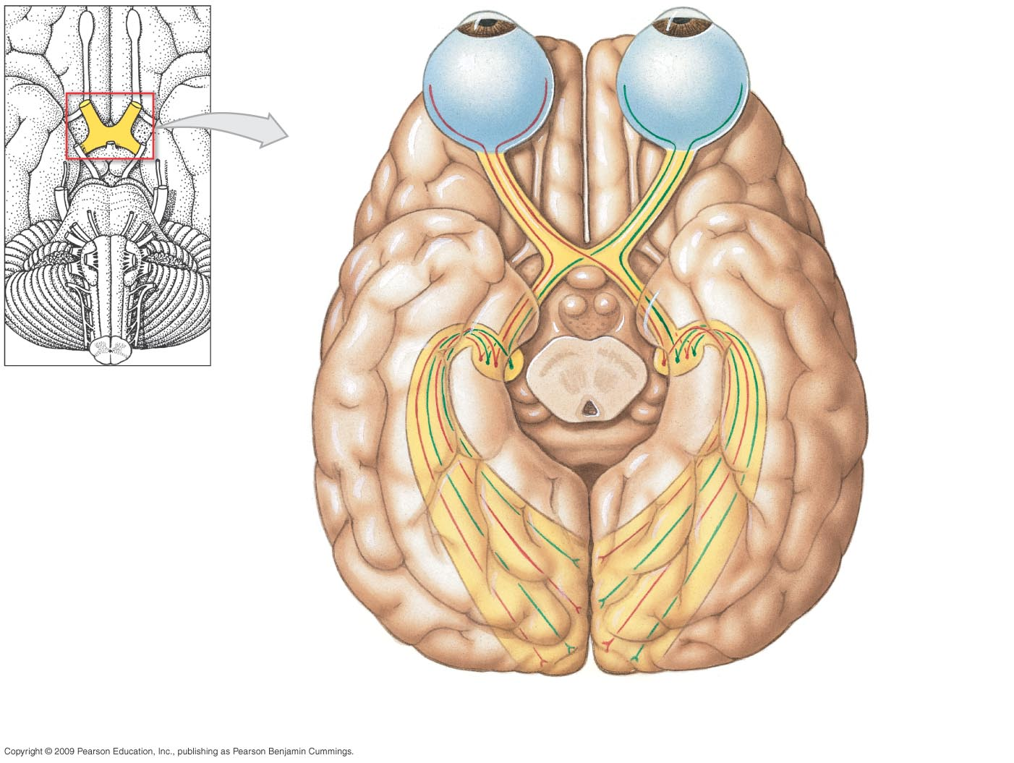
LE 15-23
Eye
Olfactory bulb
OPTIC NERVE (N II)
Olfactory tract
Optic
chiasm
Pituitary
gland
Optic
tract
Lateral
geniculate
nucleus
(in thalamus)
Mesencephalon
(cut)
Optic
projection
fibers
Visual cortex
(in occipital lobes)

Slide 49
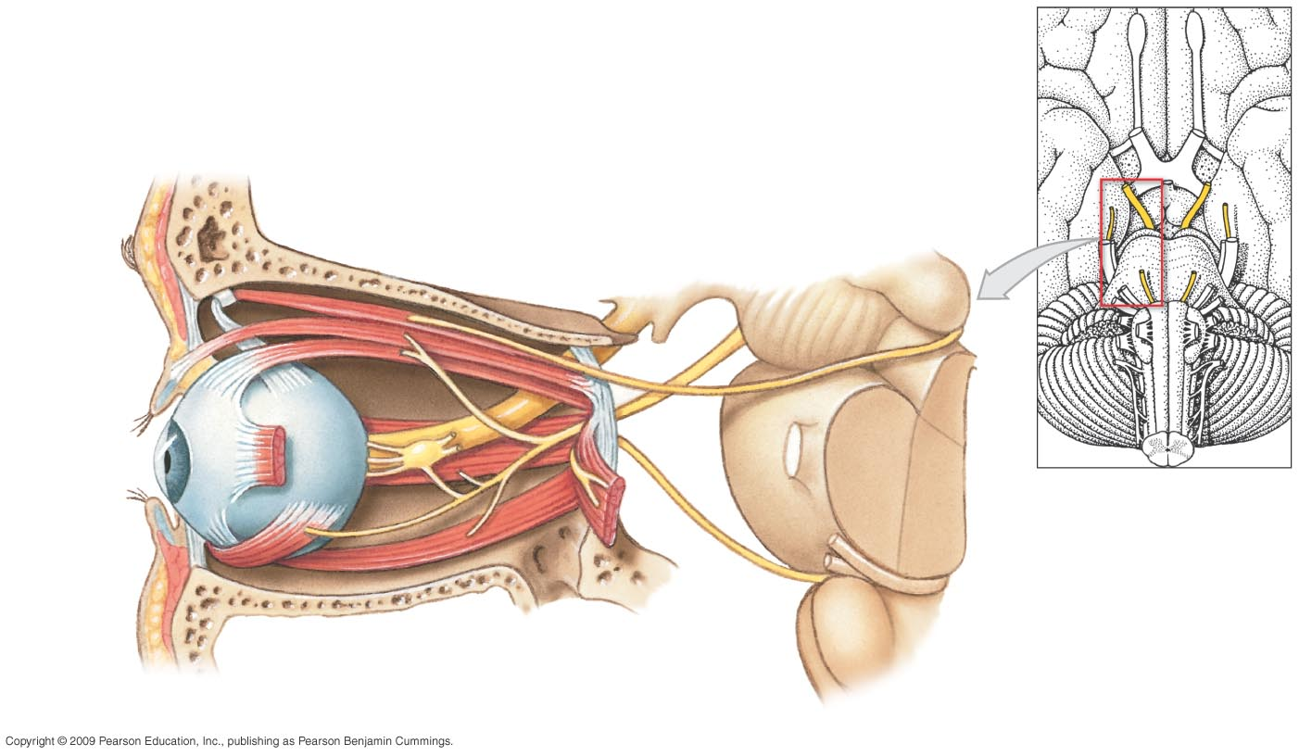
LE 15-24
OPTIC
NERVE (N II)
OCULOMOTOR
NERVE (N III)
Superior rectus
muscle
Superior
oblique
muscle
Optic
chiasm
TROCHLEAR
NERVE (N IV)
Trochlea
Levator
palpebrae
superioris
muscle
Trigeminal
nerve (N V), cut
Inferior
oblique
muscle
Vestibulocochlear
nerve (N VIII), cut
Ciliary
ganglion
Lateral rectus
muscle (cut)
Facial nerve
(N VII), cut
Inferior
rectus muscle
Medial
rectus muscle
ABDUCENS
NERVE (N VI)

Slide 50
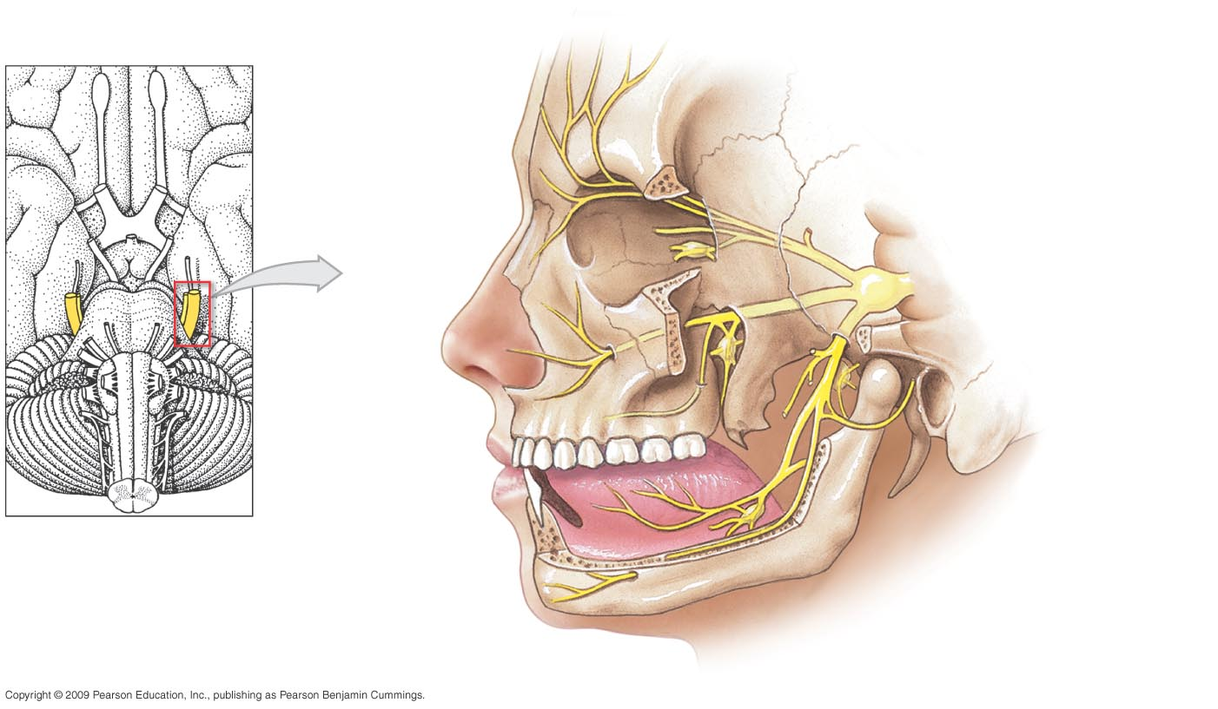
LE 15-25
Superior orbital
fissure
Semilunar
ganglion
Ophthalmic
branch
Supraorbital
nerves
Ciliary ganglion
Pons
TRIGEMINAL
NERVE (N V)
Foramen
rotundum
Maxillary
branch
Infraorbital
nerve
Foramen ovale
Lingual nerve
Otic ganglion
Submandibular ganglion
Mental nerve
Mandibular
branch
Pterygopalatine
ganglion

Slide 51
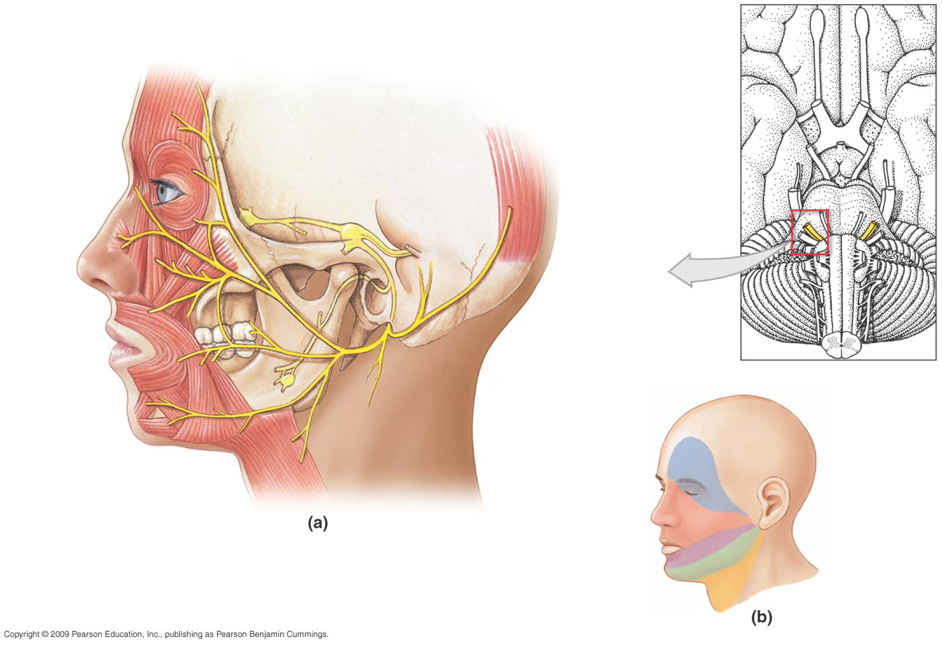
LE 15-26
Greater petrosal
nerve
FACIAL
NERVE (N VII)
Pterygopalatine
ganglion
Geniculate
ganglion
Temporal
branch
Zygomatic
branches
Pons
Posterior
auricular
branch
Stylomastoid
foramen
Buccal
branch
Mandibular
branch
Chorda tympani nerve
(with mandibular
branch of N V)
Temporal
branch
Cervical
branch
Zygomaticl
branch
Lingual branch
(with lingual nerve
of N V)
Buccal branch
Submandibular
ganglion
Mandibular
branch
Cervical branch

Slide 52
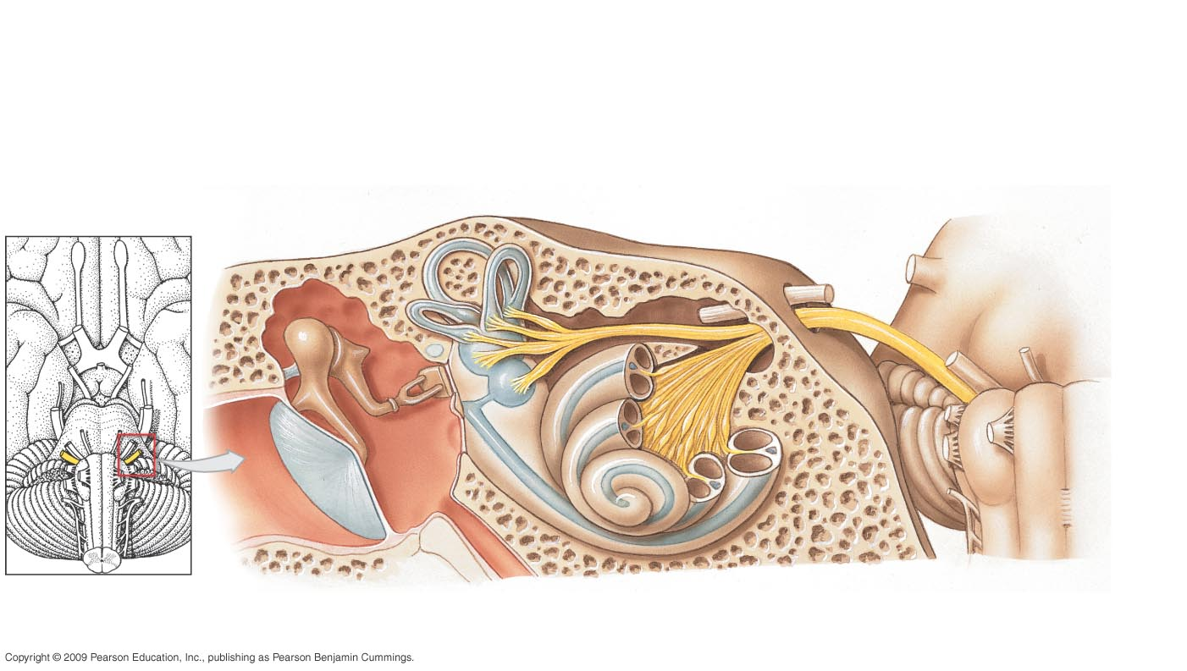
LE 15-27
Facial nerve
(N VII), cut
VESTIBULOCOCHLEAR
NERVE (N VIII)
Semicircular
canals
Tympanic cavity
(middle ear)
Vestibular
branch (N VII)
Internal
acoustic canal
N V
N VII
Pons
N VI
N IX
N XII
N X
Medulla
oblongata
Tympanic
membrane
Auditory
tube
Cochlea
Cochlear
branch (N VIII)
N XI

Slide 53
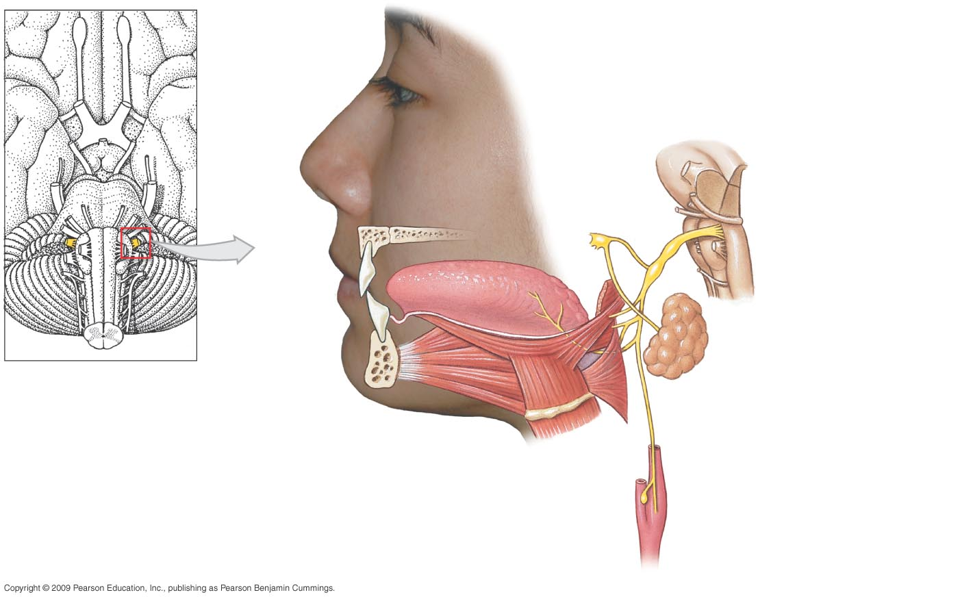
LE 15-28
Pons
N V
N VII
N VIII
Otic
ganglion
N VI
GLOSSOPHARYNGEAL
NERVE (N IX)
Inferior
(petrosal)
ganglion
Medulla oblongata
Superior (jugular)
ganglion
Pharyngeal branches
Lingual
branch
Parotid salivary gland
Carotid sinus branch
Carotid body
Carotid sinus
Common carotid artery

Slide 54
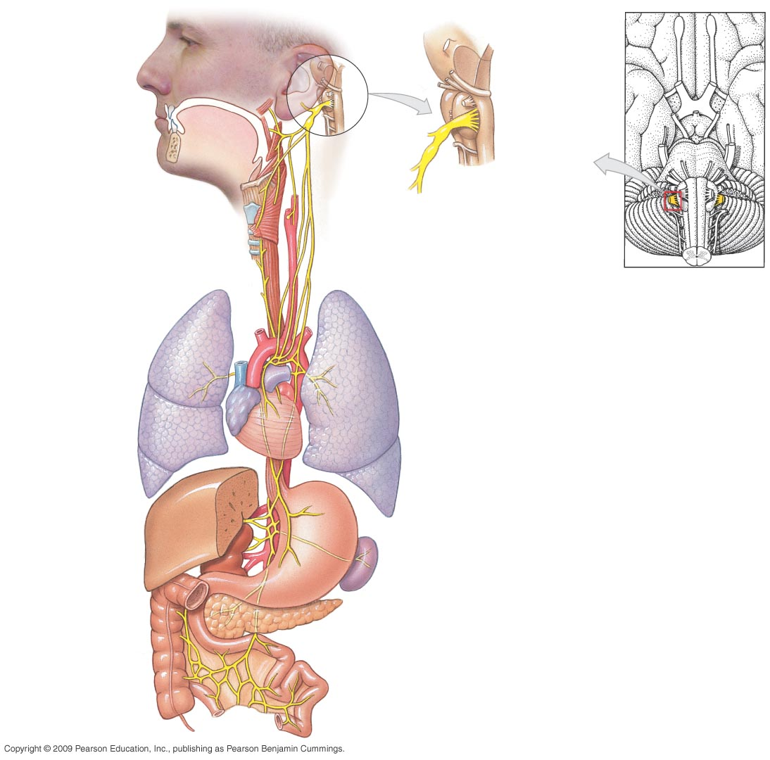
LE 15-29
Superior
pharyngeal
branch
VAGUS
NERVE (N X)
Pons
Medulla
oblongata
Auricular branch
to external ear
Superior ganglion
of vagus nerve
Inferior ganglion
of vagus nerve
Pharyngeal branch
Internal branch
Superior laryngeal nerve
Superior
laryngeal nerve
External branch
Recurrent
laryngeal nerve
Cardiac branches
Cardiac plexus
Right lung
Left lung
Liver
Anterior
vagal trunk
Stomach
Spleen
Celiac plexus
Pancreas
Colon
Small intestine
Hypogastric
plexus

Slide 55
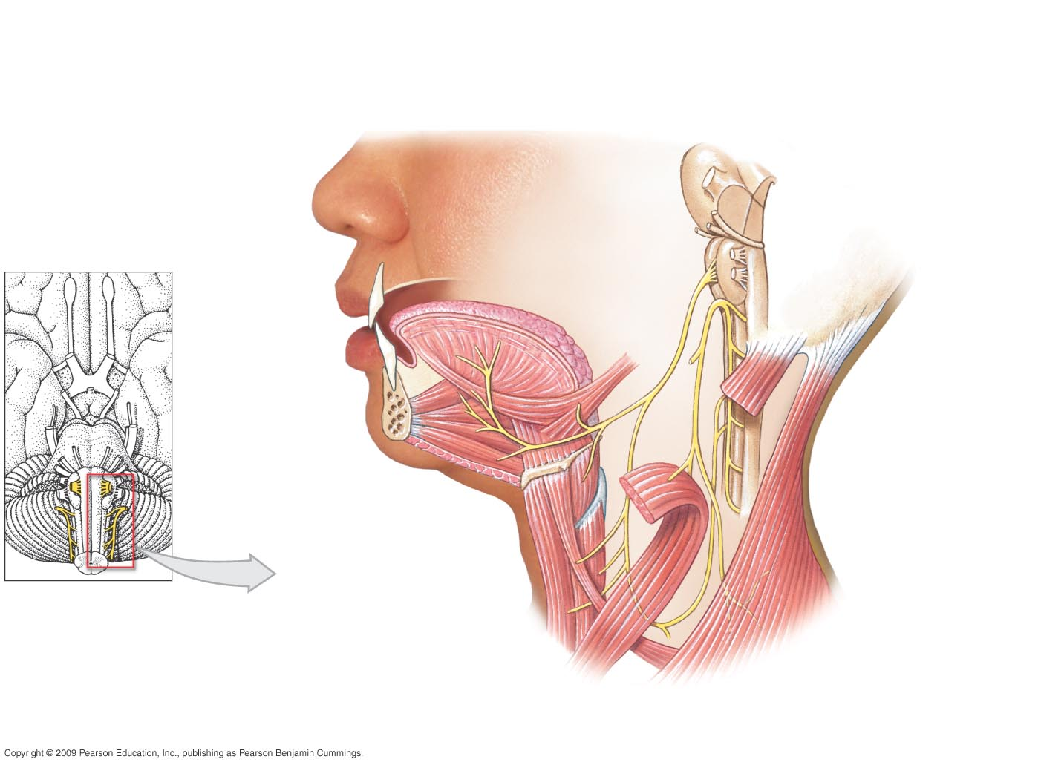
LE 15-30
Trigeminal
nerve (N V)
HYPOGLOSSAL NERVE (N XII)
ACCESSORY NERVE (N XI)
Cranial root of N XI
Internal branch:
to palatal,
pharyngeal,
and laryngeal
muscles with
vagus nerve
Medulla oblongata
Styloglossus muscle
Intrinsic
muscles
of tongue
Spinal
root of N XI
Genioglossus
muscle
External
branch of N XI
Geniohyoid
muscle
Spinal cord
Hyoglossus muscle
Trapezius muscle
Hyoid bone
Thyrohyoid muscle
Sternocleidomastoid
muscle
Sternohyoid muscle
Ansa cervicalis
(cervical plexus)
Sternothyroid muscle
Omohyoid
muscle

